Slide 1

Anthology Portfolio Training
Cooperating Teachers

Slide 2
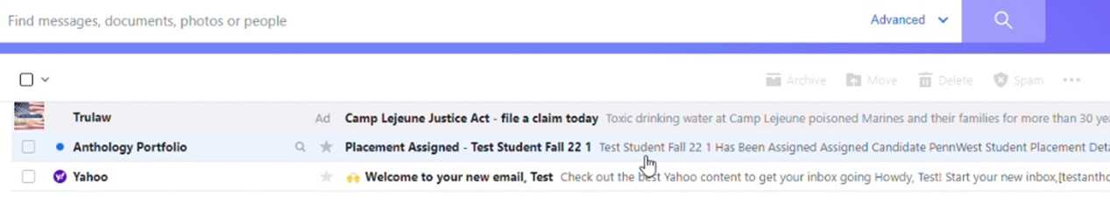
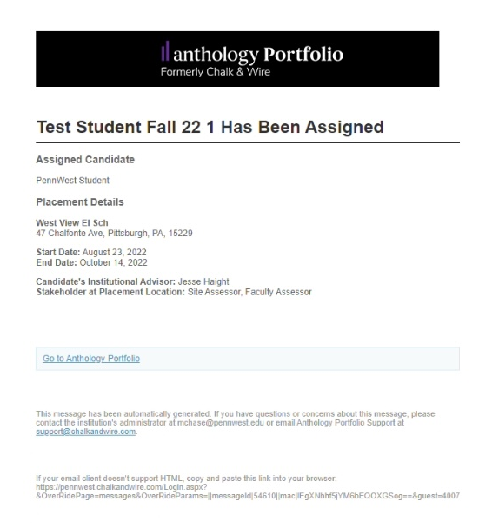
Anthology Portfolio Email
Once a placement has been created, you will receive an email from Anthology Portfolio. This email is important because the link shared is the only way for you to access the system.
If you don’t receive this email, contact your Anthology Administrator at mchase@pennwest.edu.

Slide 3
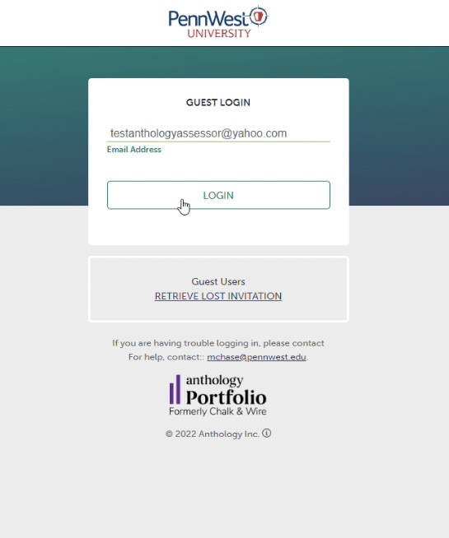
Guest Login
Enter your email address here and click the LOGIN button.
You will not need a password to enter. Your unique link is all that is needed to access Anthology Portfolio

Slide 4
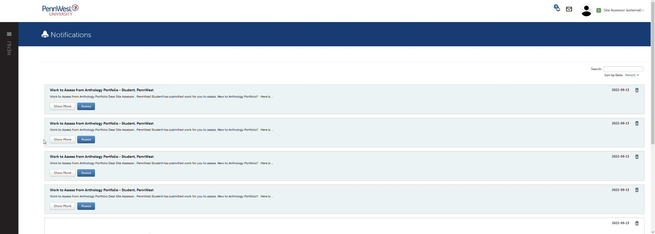
Notifications
The landing page will be your notifications. Here you will see the work you have to assess. You can click on the Assess button to enter the view of the rubric.

Slide 5
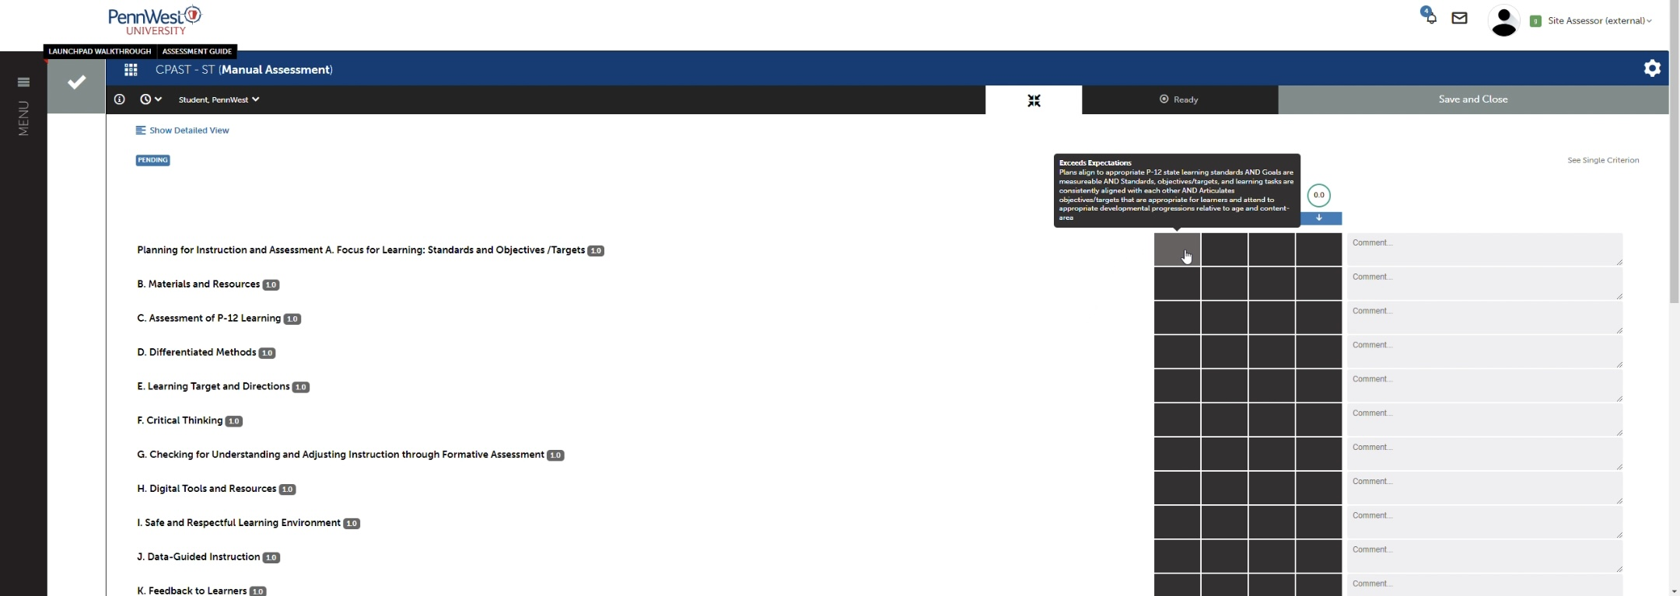
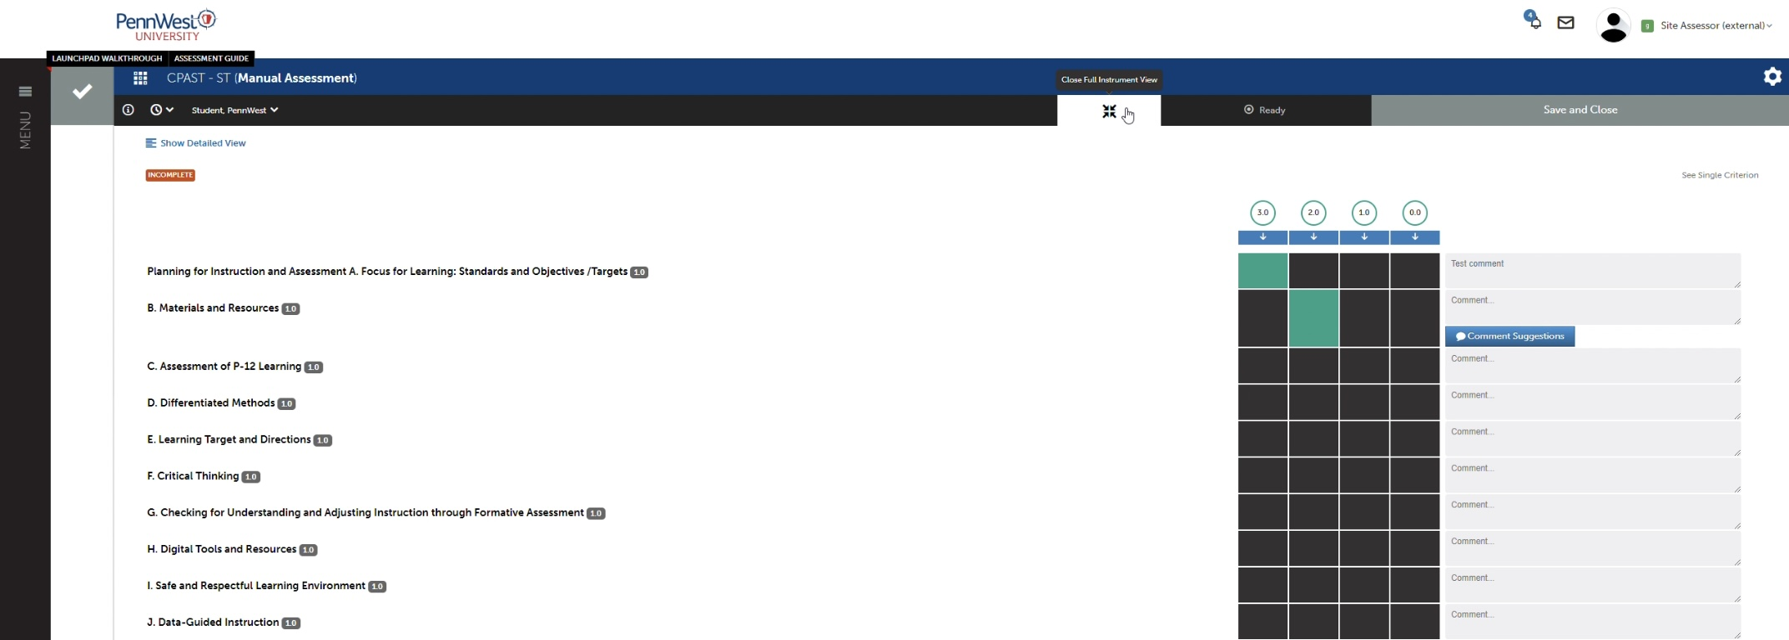
Assessing
On this page you will see the rubric for the assessment you are completing. Hover over the box and you will see the description of the level.
Once the box is clicked it will turn green letting you know the criterium has been assessed. You can also add comments to each criterium.

Slide 6
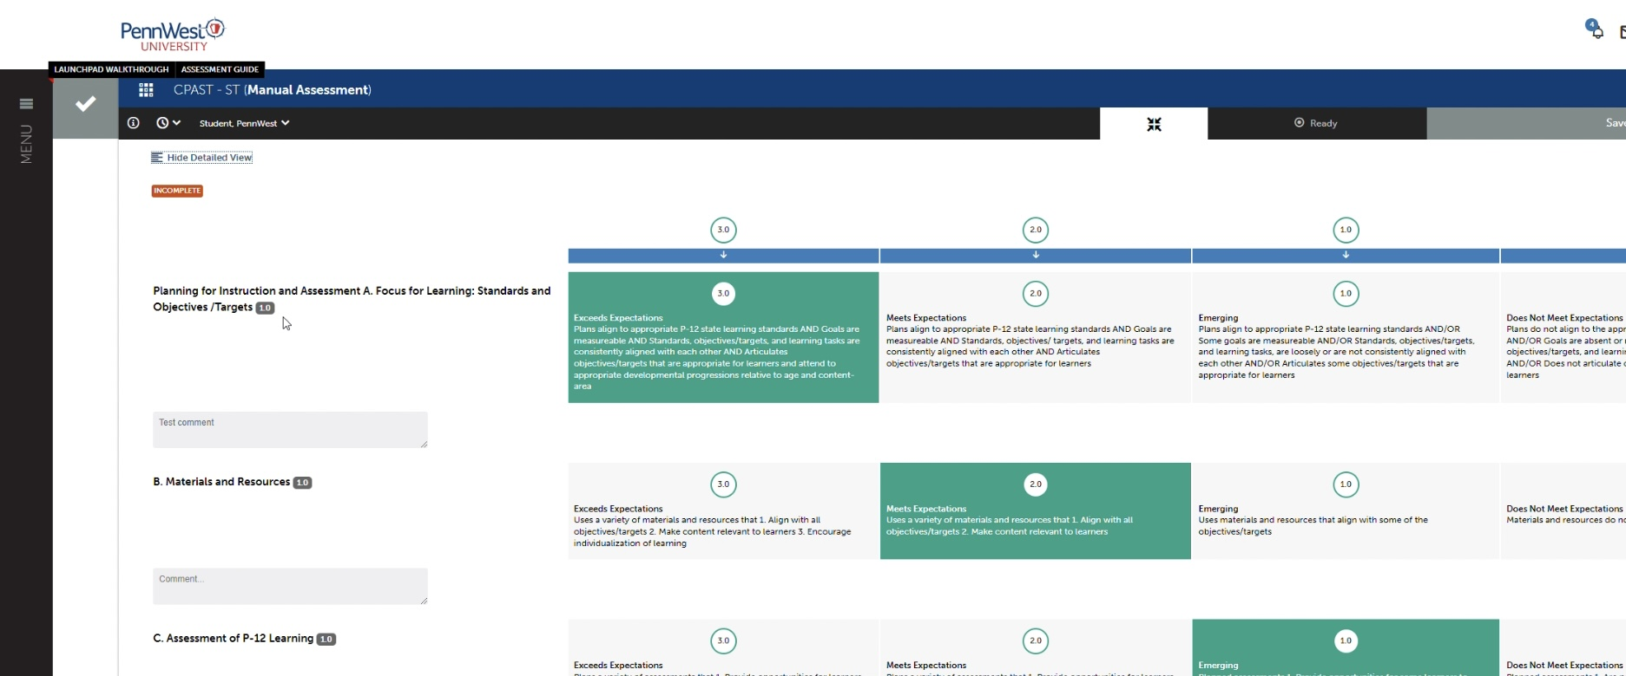
Assessing cont’d
You can also change the view of the rubric. Click on Show or Hide Detailed View in the upper left corner. This allows you to see a more detailed view without having to hover over the boxes.

Slide 7
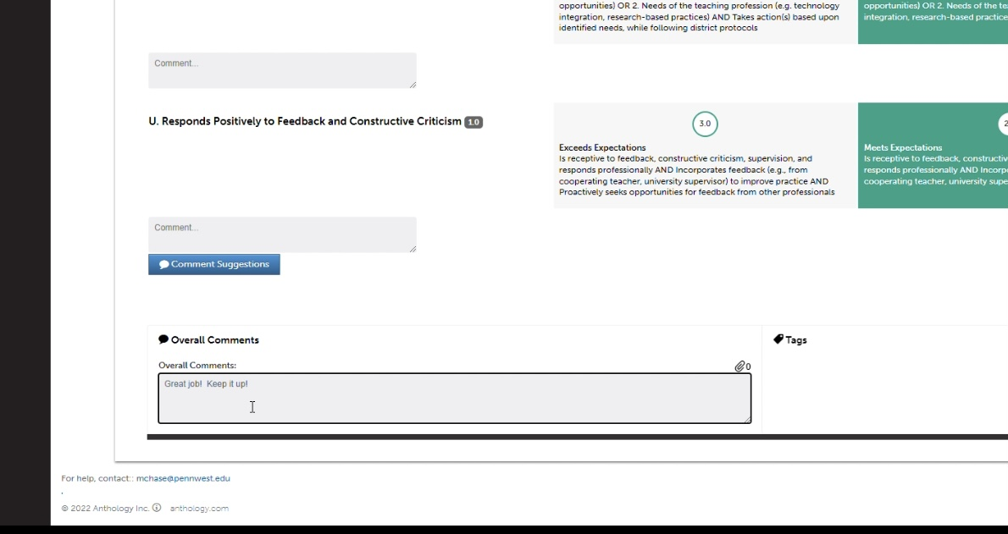
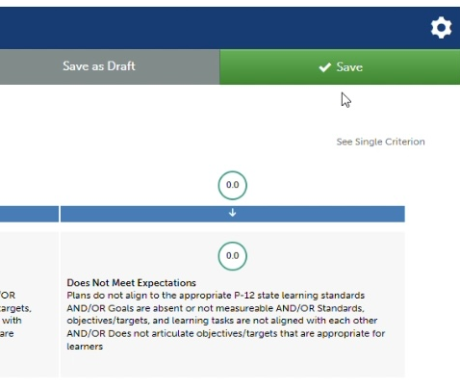
Assessing cont’d
Scroll to the bottom and you can add Overall Comments. You can also add attachments if needed by clicking on the paperclip icon.
Scroll to the top and click Save. Your assessment has been completed!

Slide 8
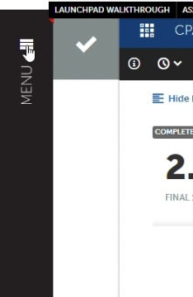
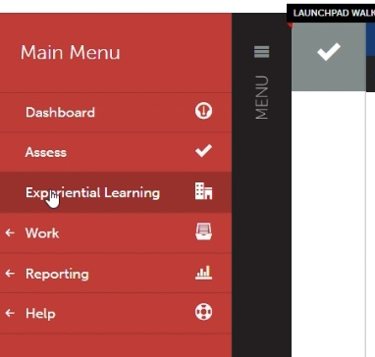
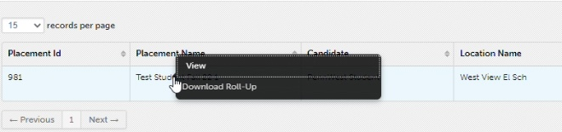
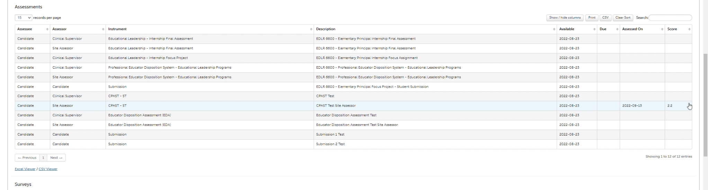
Viewing Results
To view the results of assessments completed by yourself, the faculty supervisor, or the student, click MENU, then click Experiential Learning…
On the next page, click anywhere on the row of your placement you wish to see and then click View.
You will see a list of assessment. To the right of this list is the date the assessment was completed, as well as the results of the assessment.

Slide 9
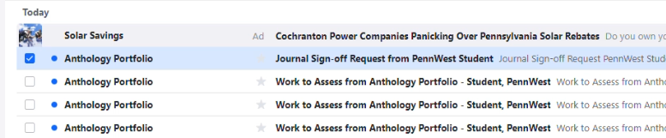
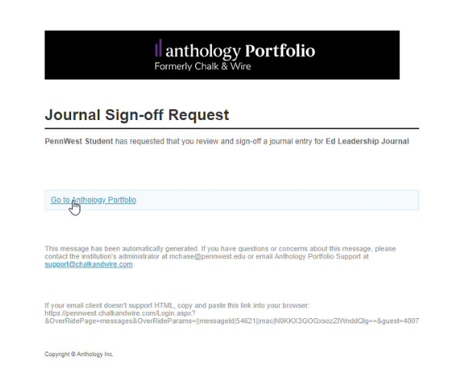
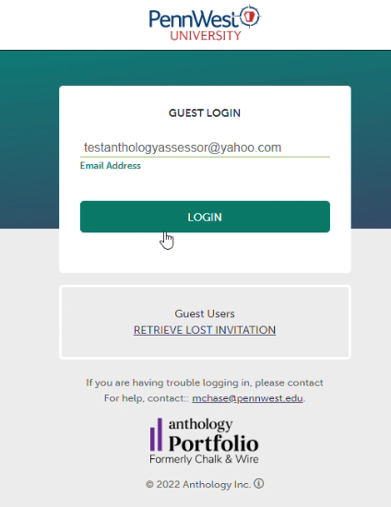
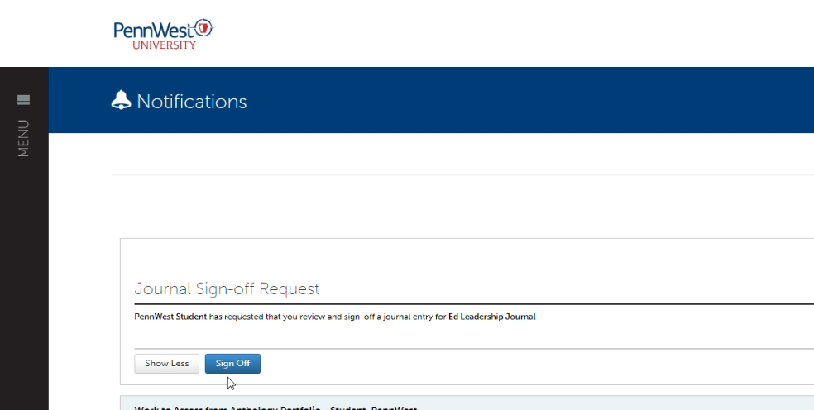
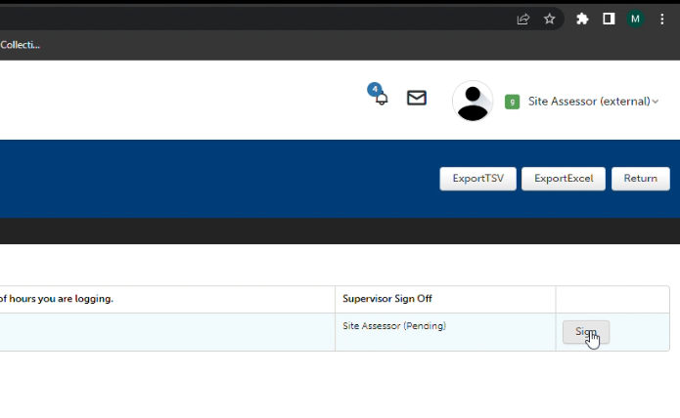
Journal Entry Sign Off
You will receive an email notification when there is a journal entry for you to sign off on.
*May not be required
Click on the link in the email to take you to the login page.
Enter your email address and click login.
After clicking Sign Off, scroll to the right of the screen and click Sign
You will now be on your notifications page, where you will see your Journal Sign-off Request. Click Sign Off.

Slide 10
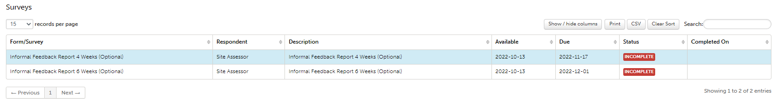
Surveys
To complete surveys, such as the Informal Feedback Report for Student Teaching, click MENU, then click Experiential Learning…
On the next page, click anywhere on the row of your placement you wish to see and then click View.
Scroll to the bottom and you will see a section for surveys. Click on the line for the survey you want to take, and then click take.

Slide 11
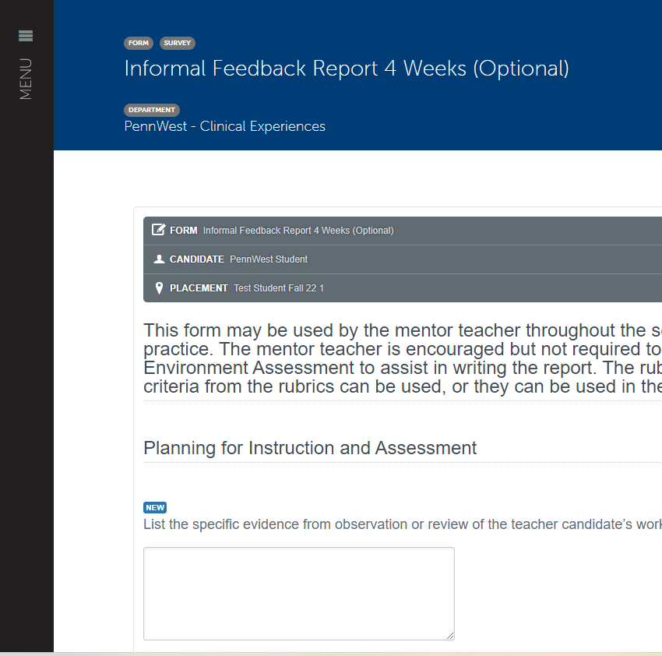
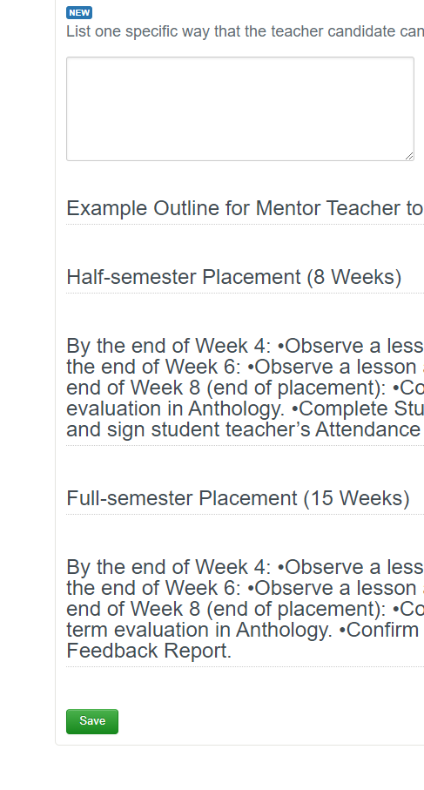
Surveys cont’d
On the next page, you will see your survey. At the top, you will see the type and name of the form, the candidate the form is meant for, and the name of the placement.
Scroll through, and fill out the questions for the survey. These may be text boxes, dropdown, multiple choice, or check boxes.
Once the survey is complete, scroll to the bottom and click save.

Slide 12
If there are any questions, please contact your Anthology Administrator at:
mchase@pennwest.edu

